Slide 1
X
X
X
X
O
O
O
Type Here
Type Here
Type Here
F1
F1
F1
F
F
F
collapse
D
D
D
No Option
G
C
G
(
(
G
G
(
(
(
G
C
(
.
.
(
.
(
.
.

Slide 4
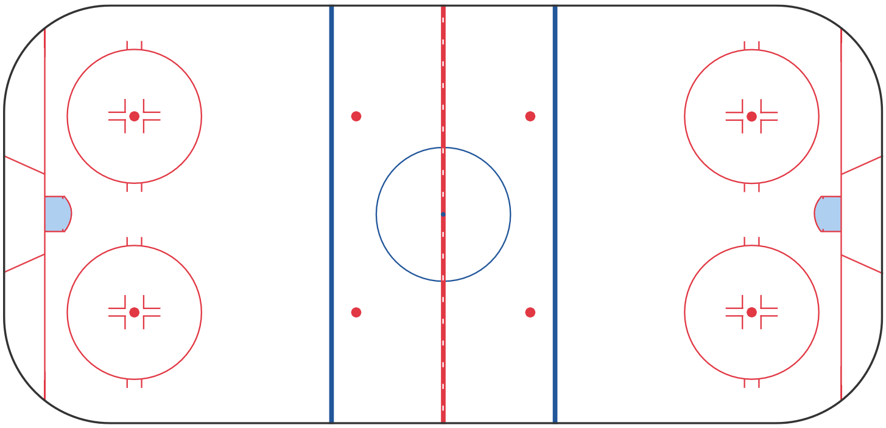
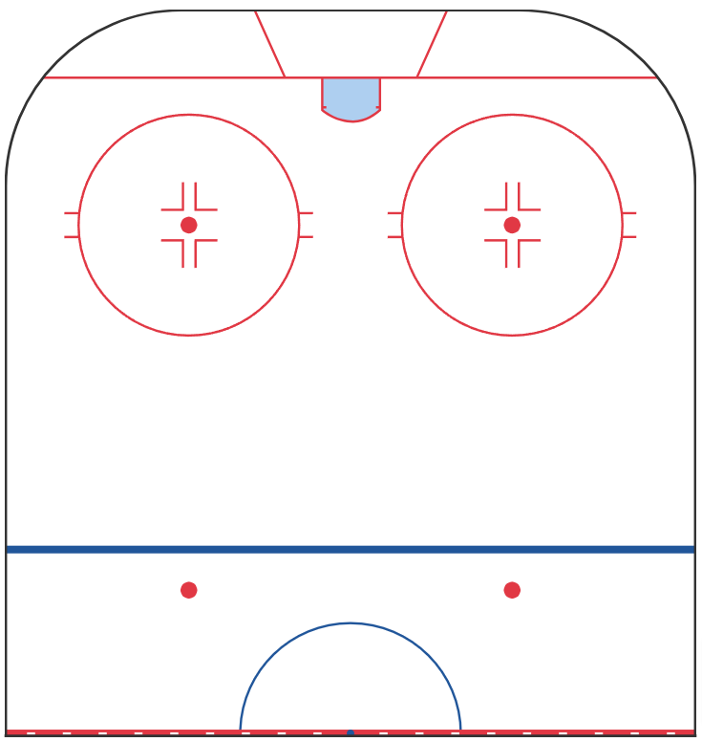
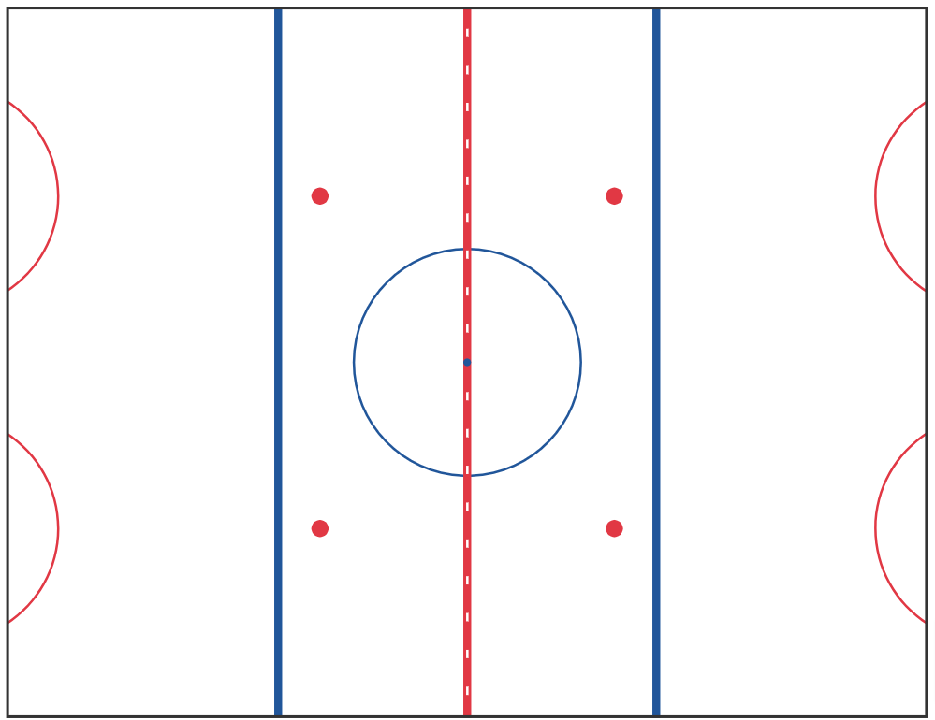

Slide 5
F
GOAL LINE BUMPER OPTION
RW to GOAL LINE
GOAL LINE TO BUMPER
D
F
D
F
F
F
F
D

